Slide 1
Recurrent Neural Networks and Variants
CSE 465
Dr. Sifat Momen

Slide 2
Recurrent Neural Networks (RNNs)
Designed to handle sequential data, where order matters.
Suitable for tasks that involve temporal dependencies and content retention.
Each piece of information depends on previous and influence future elements in the sequence.
Unlike regular data, where items can be shuffled without losing meaning, sequential data follows a specific order—changing this order alters its meaning.

Slide 3
Examples of Sequential Data
Text (Natural Language Processing)
Example: "I love programming" vs. "Programming love I“
The meaning depends on the word order.
Time Series Data
Example: Daily stock prices, weather temperatures, or heart rate over time.
Yesterday’s stock price affects today's price.
Speech and Audio
Example: A sentence in speech must be heard in order; otherwise, it becomes gibberish.
Videos
Frames in a video must play in the correct order for the story to make sense.

Slide 4
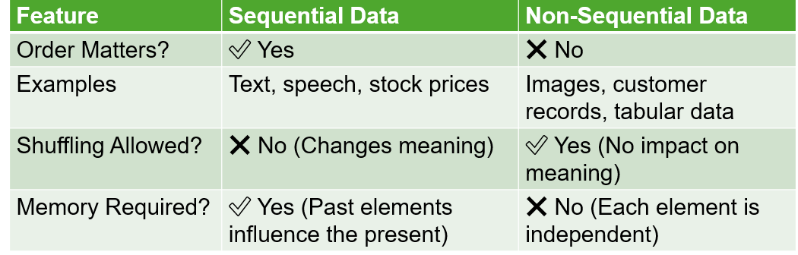
Sequential Vs. Non-Sequential Data

Slide 5


Is ANN or CNN suitable for Sequential data?

Slide 6
Why ANNs and CNNs are not suitable for sequential data?

Slide 7
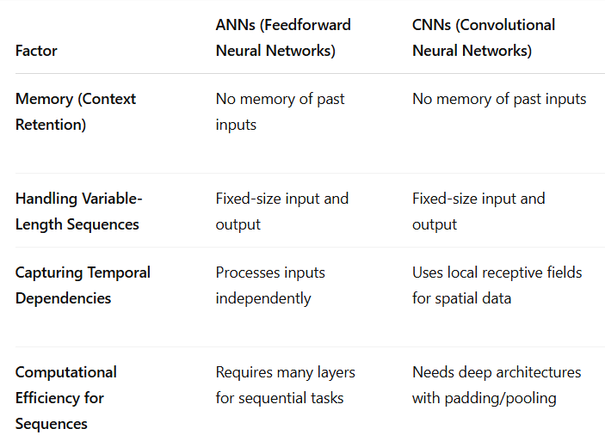
Why ANNs and CNNs are not suitable for sequential data?

Slide 8
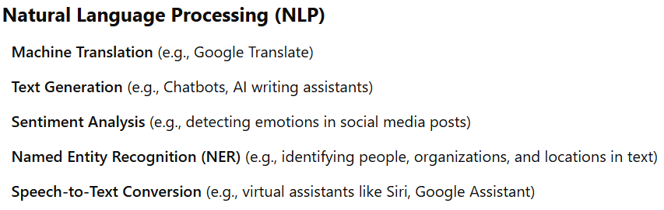
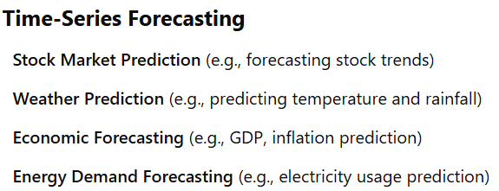
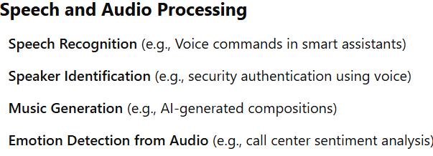
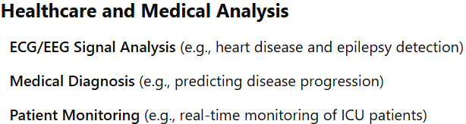
Applications of RNNs

Slide 9
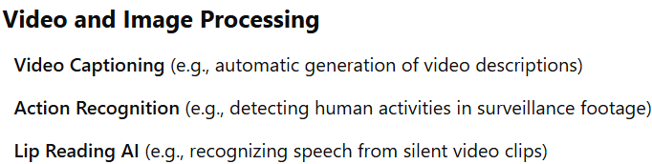
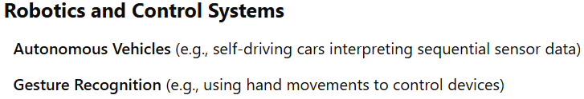
Applications of RNNs

Slide 10
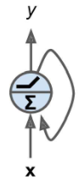
Recurrent Neurons
A Recurrent Neuron

Slide 11
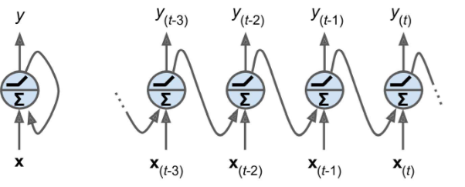
Recurrent Neurons
A Recurrent Neuron unrolled through time

Slide 12
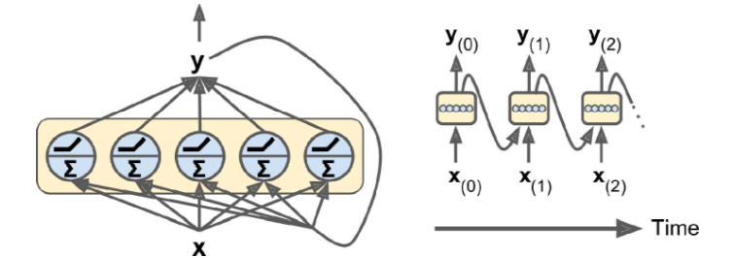
Recurrent Neurons and Layers
You can easily create a layer of recurrent neurons. At each time step t, every neuron receives the input vector x_{t} and the output vector from the previous time step y_{t-1}. Note that both input and output are vectors now (when there was a single neuron, the output was a scalar).

Slide 13
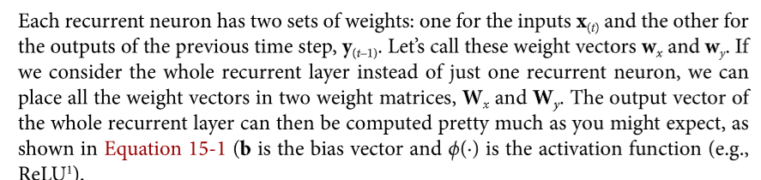
Recurrent Neurons and Layers
The weights w_{x} and w_{y} learns how much importance to give to the current input and past output.

Slide 14
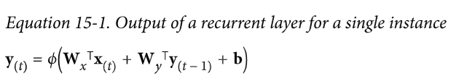
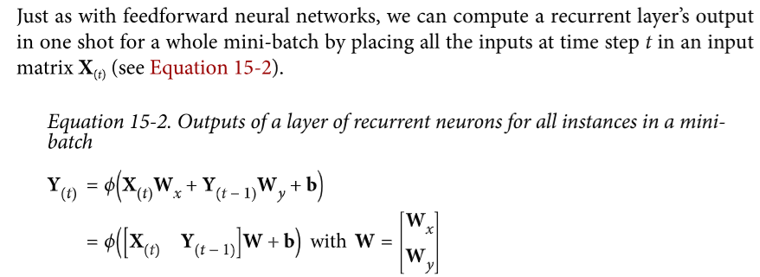
Recurrent Neurons and Layers

Slide 15
Memory Cells
Since the output of a recurrent neuron at time step t is a function of all inputs from the previous time steps, you could perceive it having a form of memory.
A part of a neural network that preserves some state across time steps is called a memory cell (or simply a cell).
A single recurrent neuron, or a layer of recurrent neurons, is a very basic cell, capable of learning of only short patterns (e.g. 10 steps long – however this depends on the task).

Slide 16
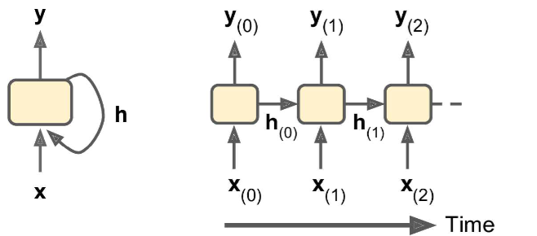
Memory Cells
In general, a cell’s state at time step t, denoted h_{t} (h for hidden) is a function of some inputs at time step t and its state at the previous time step:
h_{t} = f(h_{t-1}, x_{t})
Its output at time step t, denoted y_{t} , is also a function of the previous state and the current inputs.

Slide 17
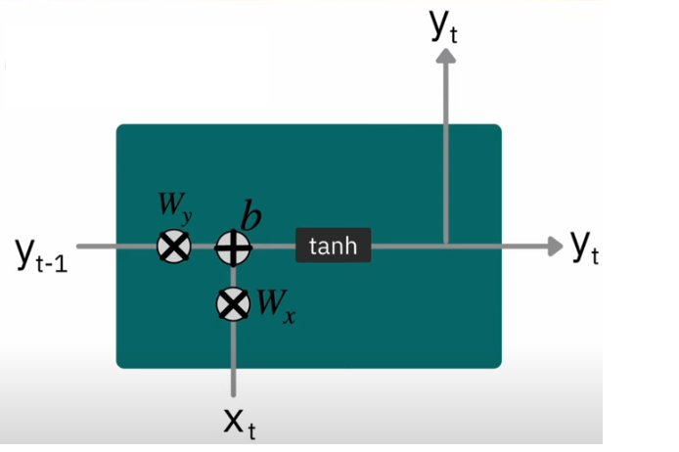
Memory Cells

Slide 18
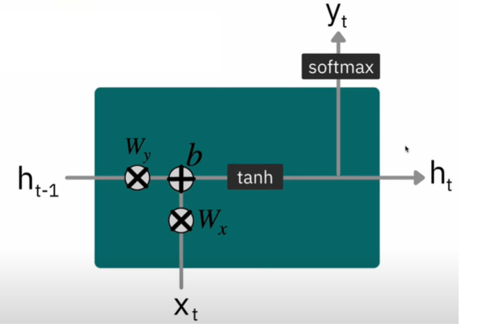
Memory Cells

Slide 19
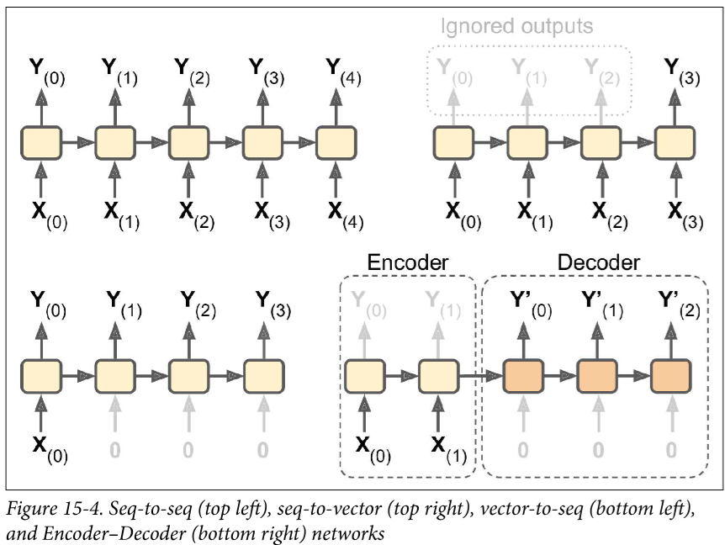
Types of RNNs
Sequence to Sequence (One to One)
Useful for predicting time series data, such as stock prices; you feed the prices over the last N days, and it must output the prices shifted by one day into the future.
Sequence to Vector (Many to One)
E.g. Sentiment score from text data
Vector to Sequence (One to Many)
E.g. from image to caption of the image
Encoder (Seq. to Vector) to Decoder (Vector to Seq.)
E.g. translating from one language to another (works better than a sequence to sequence RNN)

Slide 20
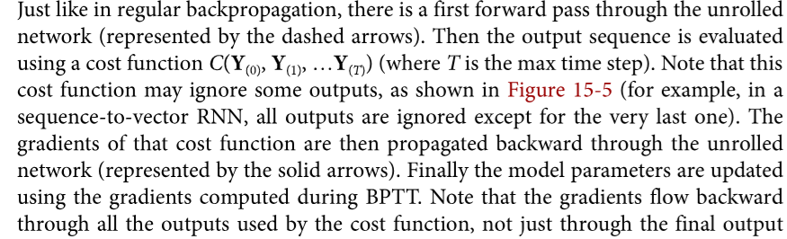
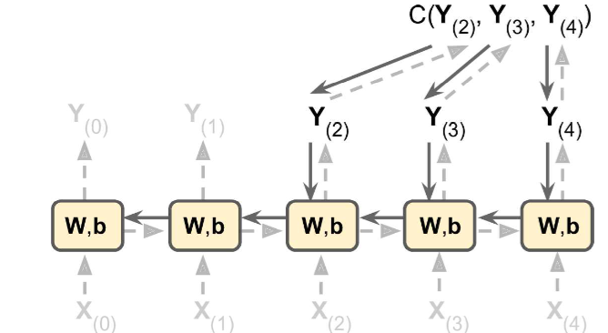
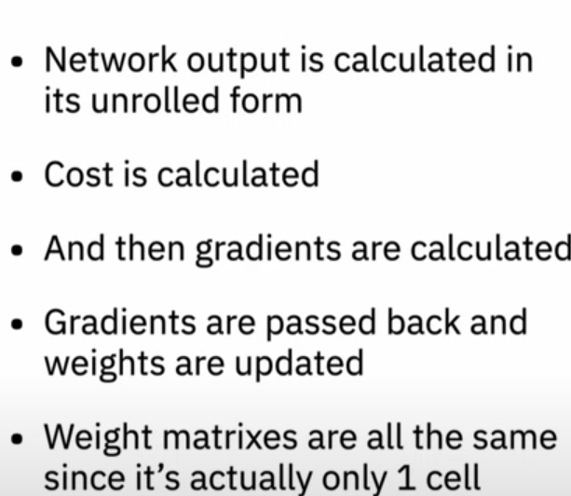
Training RNNs (Backpropagation through time – BPTT)
Note: Same parameters W and b are used at each time step

Slide 21
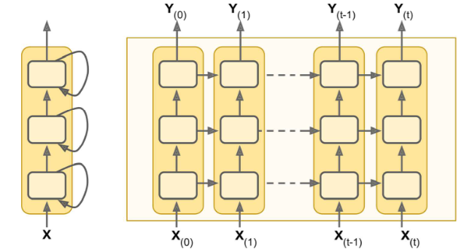
Deep RNNs
It is quite common to stack multiple layers of cells. This gives a deep RNN

Slide 22
Shortcomings of RNNs
Unstable Gradient Problems
Techniques such as good parameter initialization, faster optimizers, dropouts etc… can be used to alleviate unstable gradient problems.
Non-saturating activation function (e.g. ReLU) can lead to more instability during training (tanh is a good default choice)
Possible mitigation strategy: Use smaller learning rate
Possible mitigation strategy: Use gradient clipping
Normalization
Batch Normalization does not yield good results https://arxiv.org/pdf/1510.01378
Layer Normalization can yield better results
https://arxiv.org/pdf/1607.06450

Slide 23
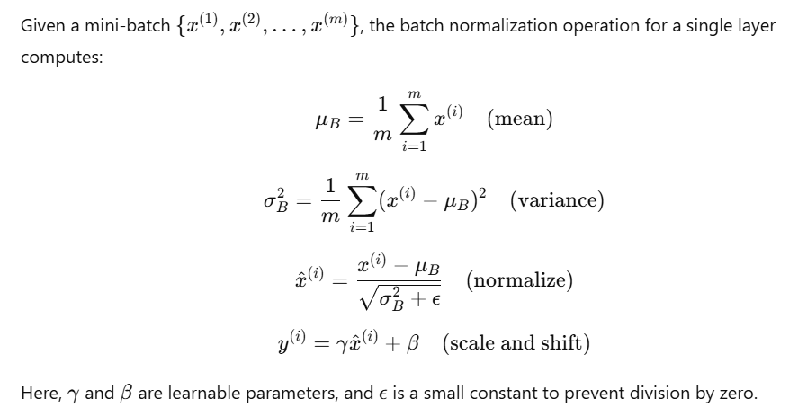
Batch Normalization

Slide 24
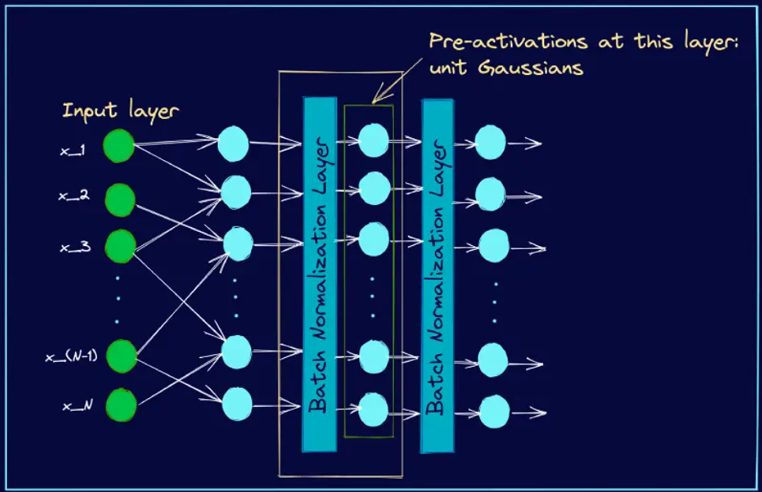
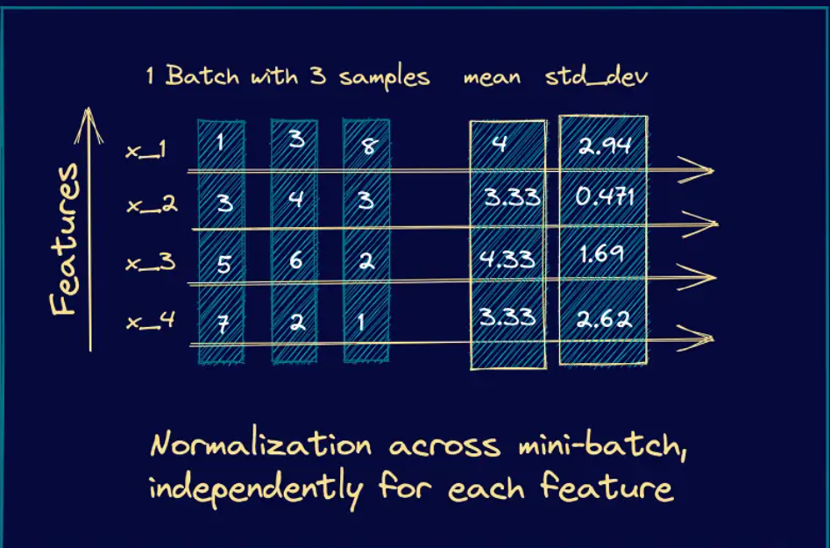
Batch Normalization

Slide 25
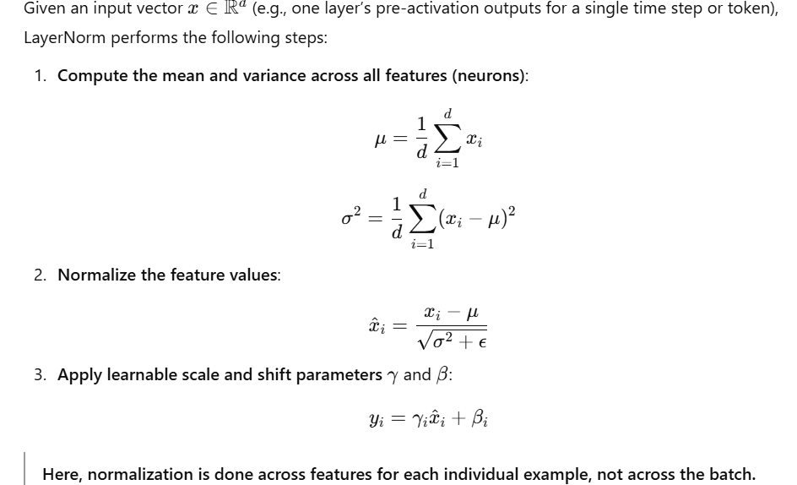
Layer Normalization

Slide 26
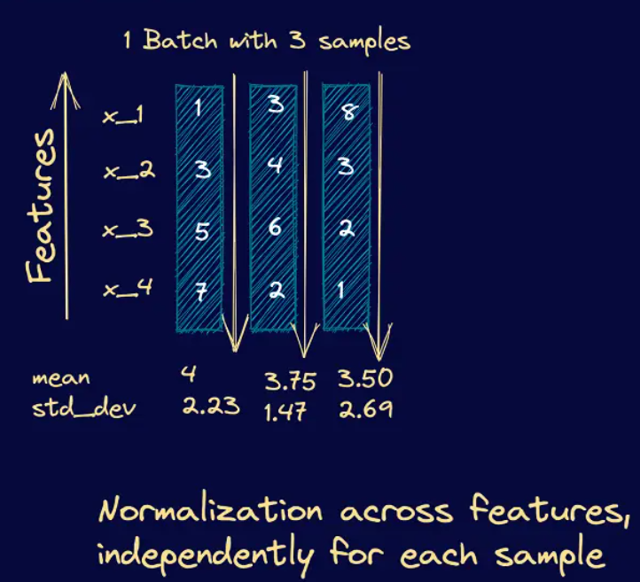
Layer Normalization
https://www.pinecone.io/learn/batch-layer-normalization/

Slide 27
Shortcomings of RNNs
Short Memory Problem
Due to the transformation that the data goes through when traversing an RNN, some information is lost at each time step.
After a while RNN’s state contains virtually no trace of the first inputs.
To tackle this problem, various types of cells with long-term memory have been introduced.
LSTM cells, GRU cells

Slide 28
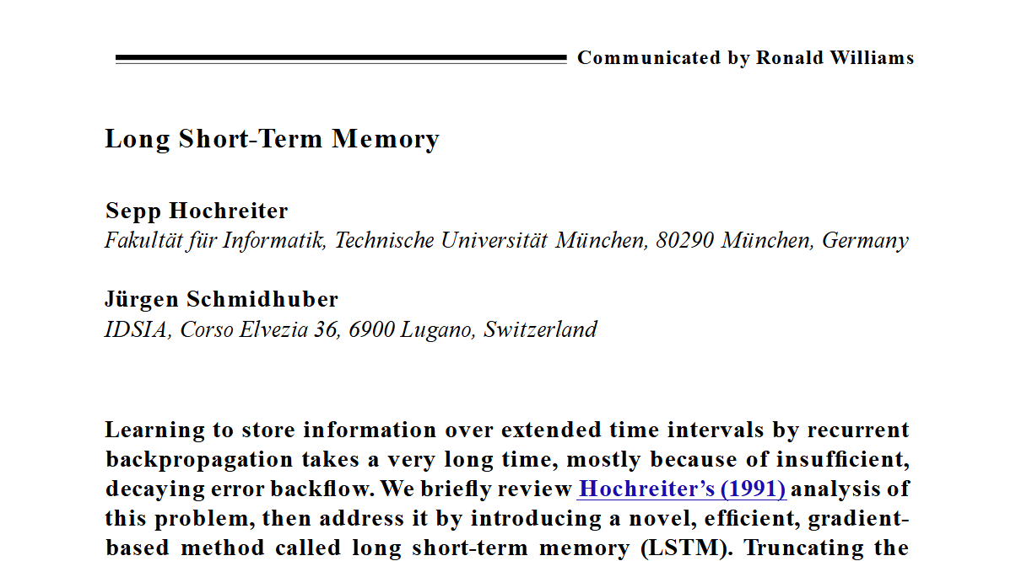
Long Short Term Memory (LSTM) Cells
First proposed by Hochreiter and Schmidhuber in 1997
The key idea is that the network can learn what to store in the long-term state, what to throw away, and what to read from it.

Slide 29
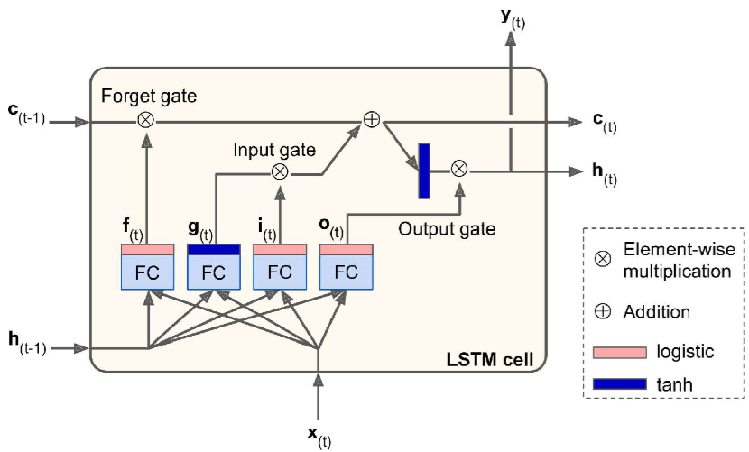
LSTM Cells
As the long-term state, c_{t-1} traverses the network from left to right, it first goes through a forget gate, dropping some memories, and then it adds some new memories via the addition operation. Moreover, after the addition operation, the long-term state is copied and passed through the tanh function and then the result is filtered by the output gate.

Slide 30
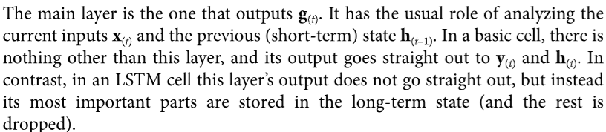
LSTM Cells
The three other layers are gate controllers. Since they use the logistic activation function, their outputs range from 0 to 1. Their outputs are fed to element-wise multiplication operation, so if they output 0s they close the gate, and if they output 1s, they open the gate.

Slide 31
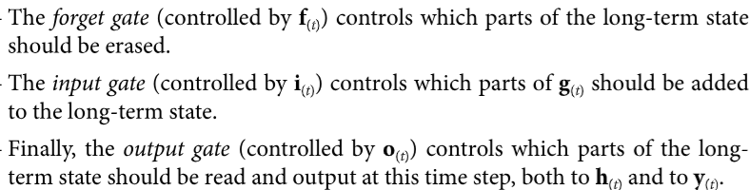
LSTM Cells

Slide 32
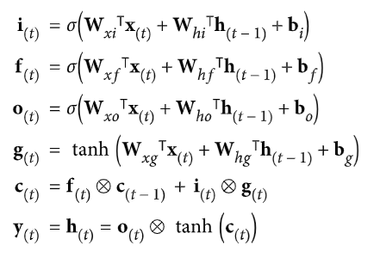
LSTM Cells

Slide 33
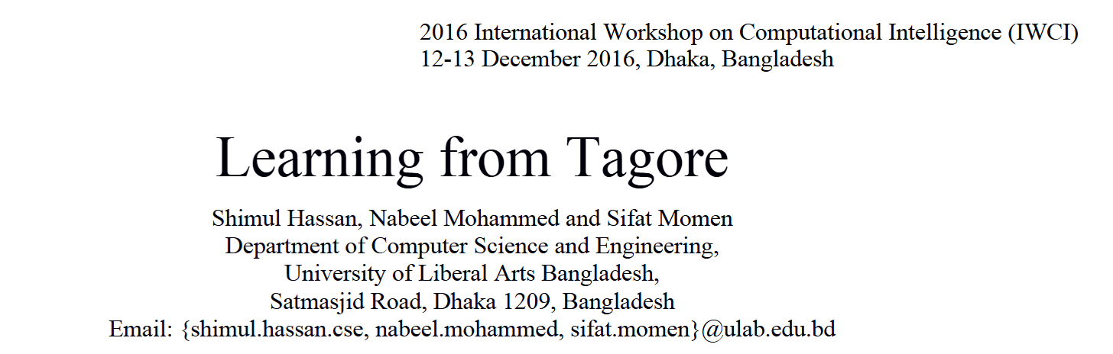
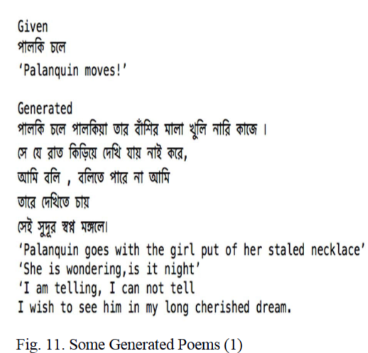
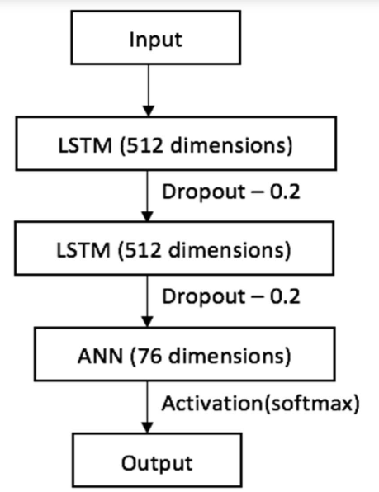
LSTM use case – An Example

Slide 34
Gated Recurrent Unit (GRU) cells
Proposed in 2014 by Kyunghyun Cho et al.
GRU cell is a simplified version of LSTM cell, and it performance is comparable to LSTM

Slide 35
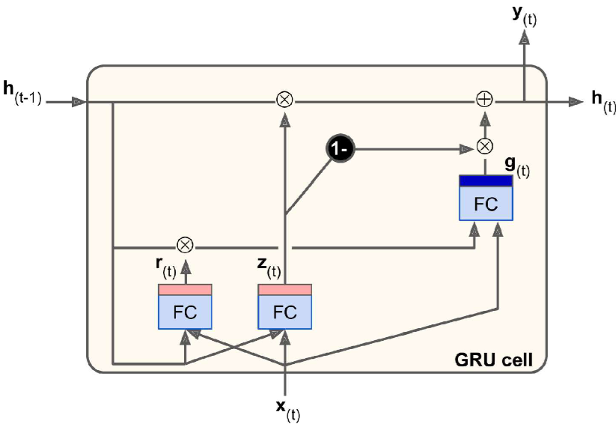
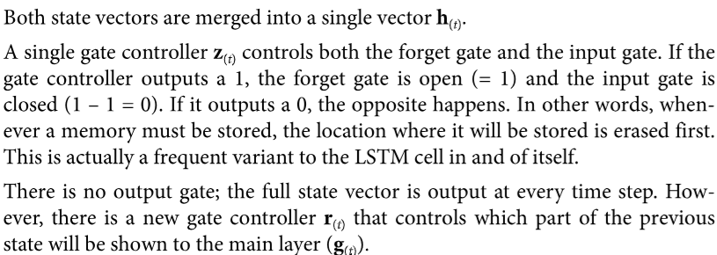
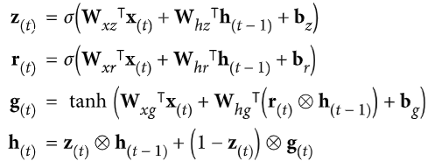
GRU Architecture and Simplification

